Slide 1
Welcome to
The 2016 Quack-a-thon
Competition Primer
Presented by the UHMC Cyber Security Interns
Mario Canul & Saxon Knight

Slide 2
What is the competition about?
Learning a simple programming language
Thinking like a hacker
Creating a system that would benefit an organization
Learning and creating policies against non-ethical usage of devices

Slide 3
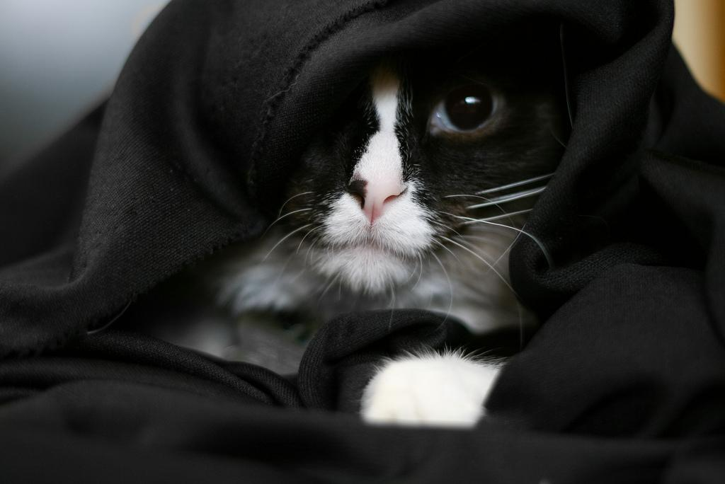
There are two paths

Slide 4

Policy Track

Slide 5
Overview: Policy Track
What is a policy?
What kind of policies are acceptable?
How are they being scored?
What do we need to present?

Slide 6

App Track

Slide 7
Overview: App Track
What is the Rubber Ducky?
How do you create a Duckyscript?
Is there a tutorial somewhere? (spoiler: yes)
How is the script being scored?
Can you show us how it’s done?

Slide 8
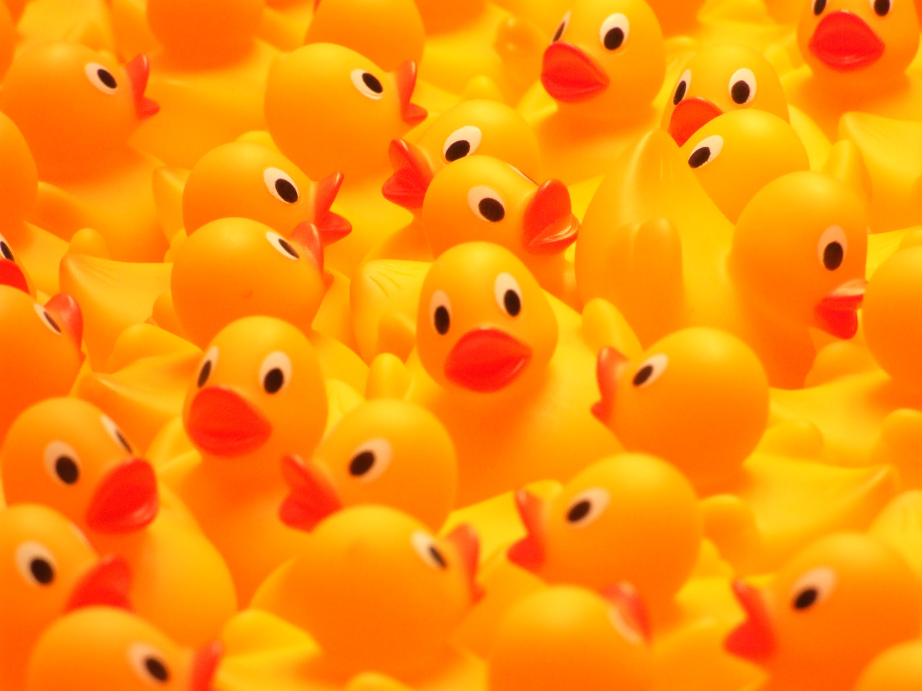
What the duck?
???
Source: wikimedia.org

Slide 9
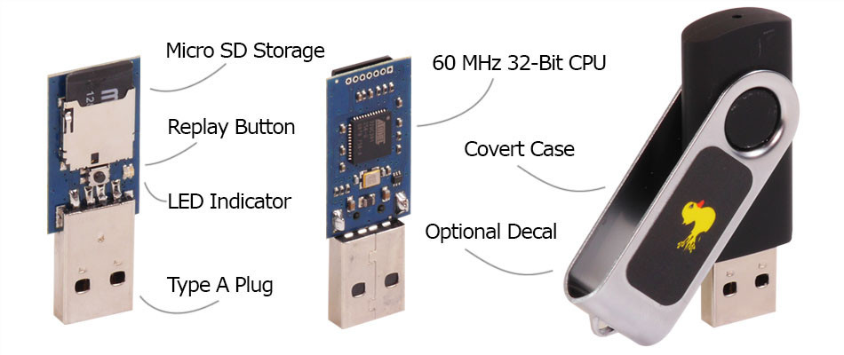
This the duck.
Source: http://usbrubberducky.com/

Slide 10
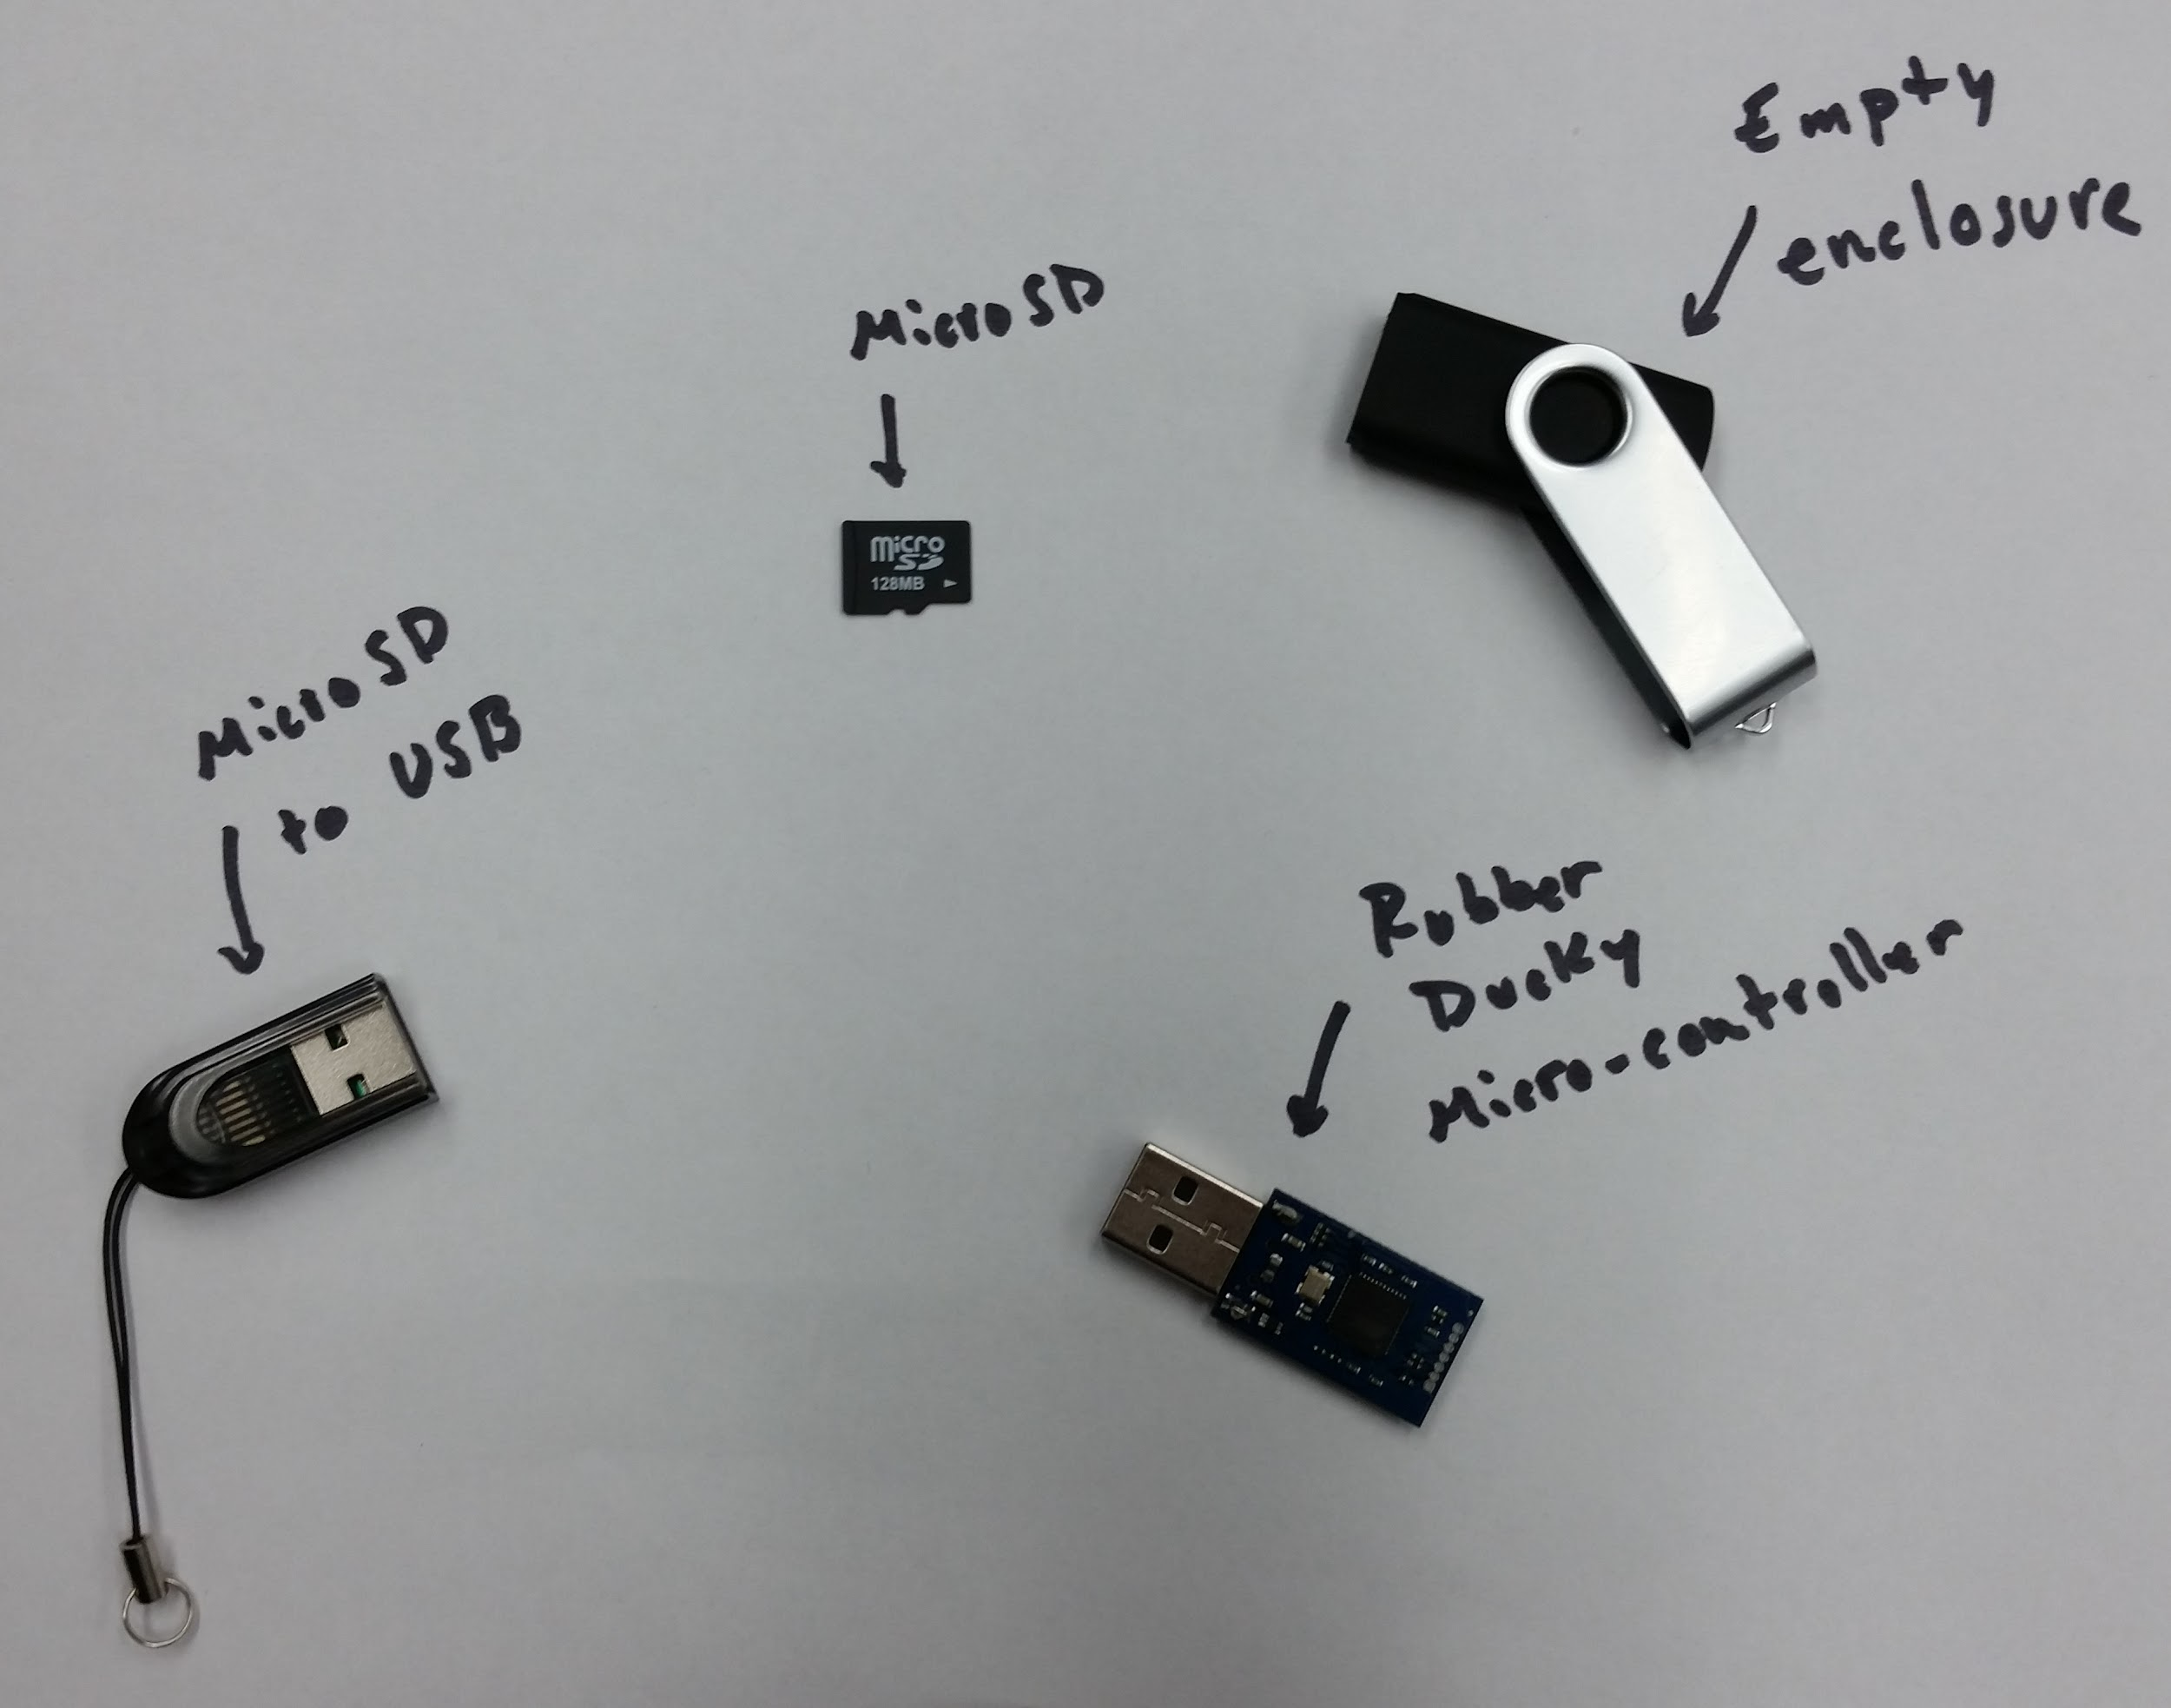

Slide 11
How It Works
Write
Encode
Load
Deploy

Slide 12
Grading Points
Results - Did it work?
Teamwork - How well do you work with your classmates?
Documentation - How well do you document your code?
Originality - Did you create something new?
Destructibility - No! Bad!

Slide 13
To the tutorial!
Head on over to http://uhmc.github.io/Ducky_Demo/ to get a step-by-step tutorial.

